Slide 1
Introduction to Data, Information and RDBMS
Ling Xue
Department of Management Information Systems
Terry College of Business
University of Georgia

Slide 2
Objectives
Learn definition of important terms
Recognize limitations of conventional file processing
Identify benefits and costs of databases
Describe evolution of database systems
List components of database environment
Database is very important
in today’s information systems environment!
Notes:
Introduce the basic concepts of databases and database management systems.
Describe traditional file management systems and some of their shortcomings
Benefit, costs, and risk of using the database approach
Summarize the evolution of database systems and review the range of technologies used to build, use and manage database.

Slide 3
Basic Concepts and Definitions
Data, information, metadata
Database, DBMS
Data model, entity, relationship, relational database
Repository
Data independence

Slide 4
Data placed in context or summarized
Facts, text, graphics, images, etc.
Centralized storehouse for all data definitions
Organized collection of related data
Data description including definitions and constraints
Data
Information
Database
Repository
Metadata
Database management system
Data independence
A software application that is used to create, maintain and provide controlled access to user databases
Separation of data description from programs

Slide 5
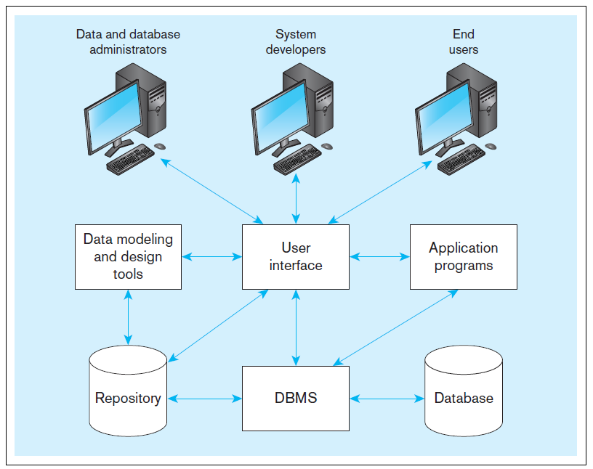
Components of the database environment
Notes:
Data modeling and design tools are automated tools used to design databases and application programs. These tools help with creation of data models and in some cases can also help automatically generate the “code” needed to create the database.
A repository is a centralized knowledge base for all data definitions, data relationships, screen and report formats, and other system components. In other words, the metadata resides in the repository.
DBMS is a software system that is used to create, maintain, and provide controlled access to databases. A database is an organized collection of logically related data, usually designed to meet the information needs of multiple users in an organization. A database is not the same as a repository. The database contains data, whereas the repository contains metadata. In other words, the repository defines the structure of the data.
Application programs interact with the database to provide functionality of use for the company. The application programs fulfill the order processing, invoicing, and payroll functions.
The user interface includes languages, menus, and other facilities by which users interact with various system components. Most application programs will involve user interfaces, because they will be directly used by people (users). However, not all applications involve user interfaces; some are run as batch programs in the background.
Different types of users include data and database administrators, system developers, and end users. The data administrators manage the data and database. The developers create the application programs. The end users are people who use the systems for various business functions. These can include accountants, sales people, managers, etc. Database administrators and system developers are IT people, and their principal clientele involve end users.

Slide 6
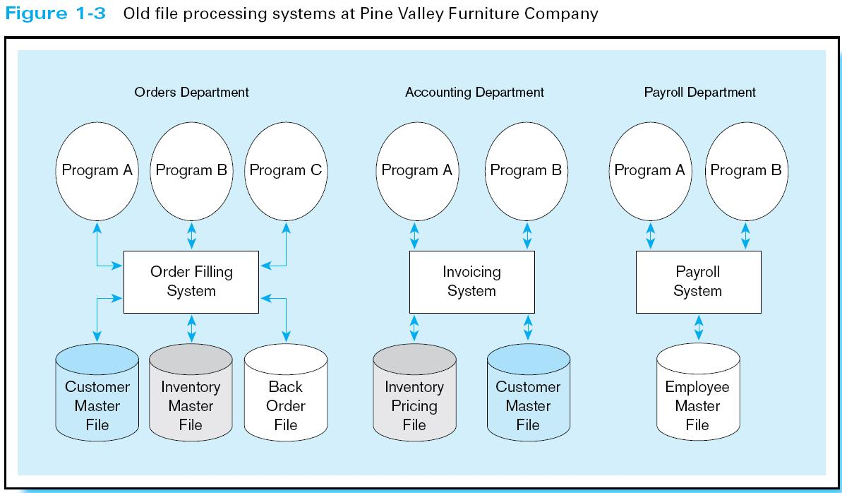
File Processing Systems
Computers have to store, manipulate, and retrieve large files of data for business applications.
Notes:
Computers are able to process a large amount of data. When computers were first introduced into the business world, there were no databases. Computer file processing systems were developed to store, manipulate, and retrieve large files of data.
Data were stored in individual files, each being used by a separate program. This was the traditional file processing approach to data storage.

Slide 7

Disadvantages of File Processing
Duplication of Data, Data Redundancy
Different systems/programs have separate copies of the same data
Data Inconsistency, Limited Data Sharing
No centralized control of data
Program-Data Dependence
All programs maintain metadata for each data file they use
Lengthy Development Times
Programmers must design their own file formats
Excessive Program Maintenance
80% of information systems budget
Notes:
As business applications became more complex, it became evident that traditional file processing systems had a number of shortcomings and limitations. Database systems were developed to overcome these shortcomings.
However, there is still a lot of data that is stored in traditional file systems. Legacy systems still abound with traditional files. Even Excel spreadsheets, which are relatively modern, would be considered to fall within the same category as file systems. Many companies store their important data in myriad spreadsheets, and as their businesses become more complex they run up against the limitations of these storage methods.

Slide 8
Desirable DB Features: Data Mgmt.
CRUD (Create/Read/Update/Delete)
Retrieval (=Read)
Locate data in specific ways
Consistency
Same query returns the same result
Validity
Data can be validated when a record is created, updated, or deleted
Easy Error Correction
Speed
Notes:
Specific and efficient ways: to structure the data so that it is relatively quick and easy to fetch data in a particular manner; breaking data, storing in distributive ways, creating indices, etc.
Consistency: you might be able to store one set of contact information in a customer's order and a different set of information in the main customer record. Later, if you need to contact the customer with a question about the order, which contact information should you use?

Slide 9
Anomalies
Create Anomalies
Update Anomalies
Delete Anomalies
How are they related to data redundancy?
Why do we need to get rid of data redundancy? How?
Notes:
Specific and efficient ways: to structure the data so that it is relatively quick and easy to fetch data in a particular manner; breaking data, storing in distributive ways, creating indices, etc.
Consistency: you might be able to store one set of contact information in a customer's order and a different set of information in the main customer record. Later, if you need to contact the customer with a question about the order, which contact information should you use?

Slide 10
Desirable DB Features: Transactions
ACID: Atomicity, Consistency, Isolation, and Durability
Atomicity: The operations in a transaction either all happen or none of them happen.
Consistency: the transaction ensures that the database is in a consistent state before and after the transaction.
Isolation: the transaction isolates the details of the transaction from everyone except the person making the transaction.
Durability: once a transaction is committed, it will not disappear later.
Notes:
Specific and efficient ways: to structure the data so that it is relatively quick and easy to fetch data in a particular manner; breaking data, storing in distributive ways, creating indices, etc.
Consistency: you might be able to store one set of contact information in a customer's order and a different set of information in the main customer record. Later, if you need to contact the customer with a question about the order, which contact information should you use?

Slide 11
Advantages of the Database Approach
Planned data redundancy
Improved data consistency
Improved data sharing
Program-data independence
Increased application development productivity
Improved data quality
Improved data accessibility and responsiveness
Reduced program maintenance
Improved decision support

Slide 12
Desirable DB Features: Other
Persistence and backups
Low cost and extensibility
Ease of use
Portability
Security
Sharing
Ability to perform complex calculations
Notes:
Also called Brewer's theorem after computer scientist Eric Brewer, who devised it
any distributed data store can only provide two of the following reliably

Slide 13
Distributed DB: CAP Theorem
Consistency—Every read receives the most recently written data (or an error).
Availability—Every read receives a non-error response, if you don't guarantee that it receives the most recently written data.
Partition tolerance—The data store continues to work even if messages are dropped or delayed by the network between the store's partitions.
When a partition failure occurs, you need to decide whether to either (a) cancel the operation (and reduce availability), or (b) have the operation continue (but risk inconsistency).
Notes:
Also called Brewer's theorem after computer scientist Eric Brewer, who devised it
any distributed data store can only provide two of the following reliably

Slide 14
Desirable DB Features: NoSQL
BASE: Basically Available; Soft state; Eventually consistent
NoSQL databases are typically distributed and often with special structures, require flexibility and scalability
Basically Available: any query will return results, might not be immediately consistent
Soft state: changes of data may take time to filter through the entire system.
Eventually consistent: data will eventually become consistent.
Notes:
Also called Brewer's theorem after computer scientist Eric Brewer, who devised it
any distributed data store can only provide two of the following reliably

Slide 15
Costs and Risks of the Database Approach
New, specialized personnel
Installation and management cost and complexity
Conversion costs
Need for explicit backup and recovery
Organizational conflict

Slide 16
Basic Concepts and Definitions
Data: stored representations of meaningful objects and events
Input
Process
Output
Numbers,
Strings,
Dates
20
Structured
000001100
12 + 8 = 20
000001000
----------------
000010100
pitch,
volume
Sound
8 9 20 7 8 19 5 6 15
time
000001000 000001001 000010100 .....
Unstructured
Images
0010000000000000000
0100000000000001001
0110000011000011011
0111111111111001111
1111111111111011111
1111111111100011111
00101010111
00101010111
00101010111
11010101010
11010101010
11010101010
Video
01010101010
01010101010
01010101010
11110100011
11110100011
11110100011
00101011011
00101011011
00101011011
00101010111
00101010111
11010101010
11010101010
01010101010
01010101010
11110100011
11110100011
00101011011
00101011011
Notes:
Recorded and stored on computer media, like a hard disk, USB sticks
Structured: facts such as customers’ name, phone numbers, date
Unstructured (multimedia): video clip, images, maps..
Combined to create a multimedia environment. Often found on Web servers and web-enabled databases.

Slide 17
Unstructured Data
Data
Do not have a pre-defined data model
Are not stored in a structured database format
Are not organized in a pre-defined manner
Text-heavy, with image, video and sound

Slide 18
Basic Concepts and Definitions (Cont’s)
Information: data processed to increase knowledge in the person using the data.
Useful in a particular context.
Good, timely, relevant information is key to decision making.
Notes:
Data becomes useful for decision makers and knowledge workers only after the data has been processed, summarized, and organized.
Processed data becomes information, which is often made available to users in the form of reports or graphical displays.

Slide 19
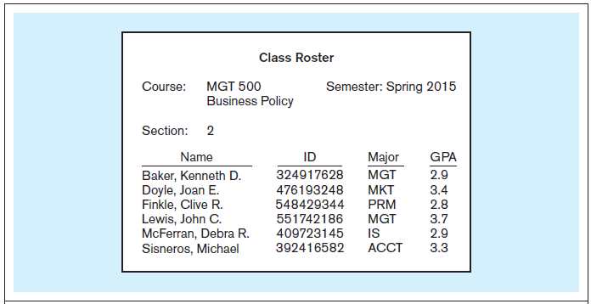
Context helps users understand data
Notes:
We have courses and sections of these courses, and we also have the students that are enrolled in a section. Thus, we have gone from just raw data to some type of useful information by organizing the data.

Slide 20
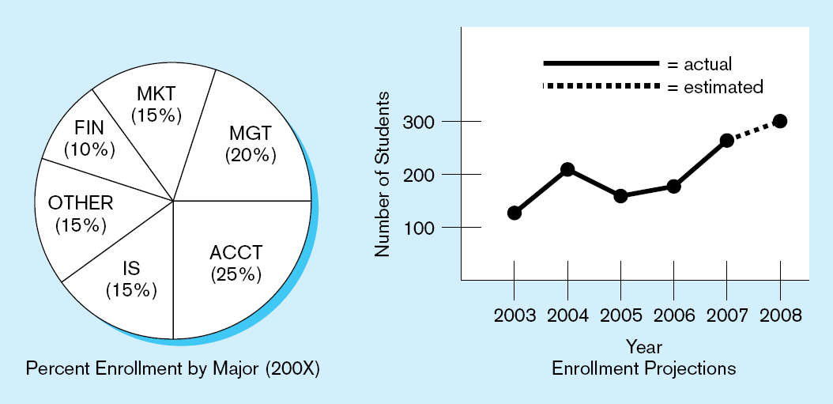
Summarized data
Graphical displays turn data into useful information that managers can use for decision making and interpretation
Context helps users understand data
Notes:
Another way to convert data into information is to summarize them. Present student enrollment data in graphical information
Here we see summaries of the data. Rather than individual data units, the data has been processed into aggregates and categories. Sums and averages are typical forms of aggregated data, and this is another way of turning raw data into useful and actionable information.

Slide 21
Basic Concepts and Definitions (Cont’s)
Metadata: data that describes the properties and characteristics of user data, and the context of that data.
Properties: data names, definitions, length, allowable values
Context: source of data, where the data are stored, ownership, usage
Metadata are separate from data.
Notes:
Metadata is not data per se. Instead it is a description of how data is to be stored and organized into a database.
Metadata really pertains to the underlying structure of the data. When you design a database, you are specifying its metadata. When you populate the database, you are putting data into it.

Slide 22
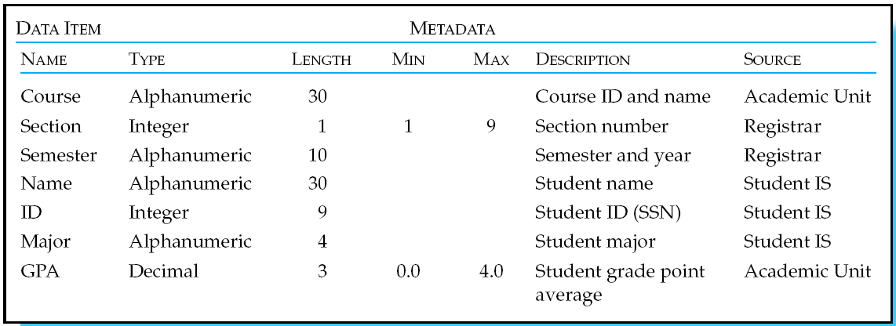
Example Metadata for Class Roster
Descriptions of the properties or characteristics of the data, including data types, field sizes, allowable values, and data context
Notes:
Metadata enable database designers and users to understand what data exist, what the data mean, and what the fine distinctions are between seemingly similar data items

Slide 23
Basic Concepts and Definitions (cont’s)
Database: an organized collection of logically related data.
Database Management System (DBMS): software system used to create, maintain, and provide controlled access to user databases.

Slide 24
Problems with Data Redundancy
Waste of space to have duplicate data.
Increased effort to keep all files up to date.
Inconsistent data format.
Different data values.
Unreliable metadata.
Notes:
Although wasted space is an issue with data redundancy, it has become less of a problem over time. Storage media is becoming less and less expensive.
The real problem, as mentioned earlier, is with data inconsistencies.

Slide 25
Problems with Data Dependency
Each application programmer must maintain his/her own data.
Each application program needs to include code for the metadata of each file (data descriptions).
Each application program must have its own processing routines for reading, inserting, updating, and deleting data.
Changes to a data file structure requires changes to programs that access the file.

Slide 26
Solution: DATABASE Approach
Database: organized collection of logically related data.
Central repository of shared data (including metadata).
Data is managed by a controlling agent.
Stored in a standardized, convenient form.
Integration and sharing.
Database Management System (DBMS): software system used to create, maintain, and provide controlled access to user databases.
Systematic method.
Control data access, enforce data integrity, manage concurrency control, restore a database.

Slide 27
Database Management System at Pine Valley Furniture Company
Order Filing
System
Central
Database
Contains employee,
order, inventory,
pricing, and
customer data
Invoicing
System
DBMS
Payroll
System
DBMS manages data resources like an operating system manages hardware resources
Notes:
The database management system (DBMS) is a software system that is used to create, maintain, and provide controlled access to user databases.
Most current DBMSs are in the form of relational databases, which represent data as a collection of tables in which all data relationships are represented by common values in related tables. We will explore relational databases in detail throughout this course.
Note that because all the data is shared in a central database. This reduces duplication and increases integrity.

